Slide 1
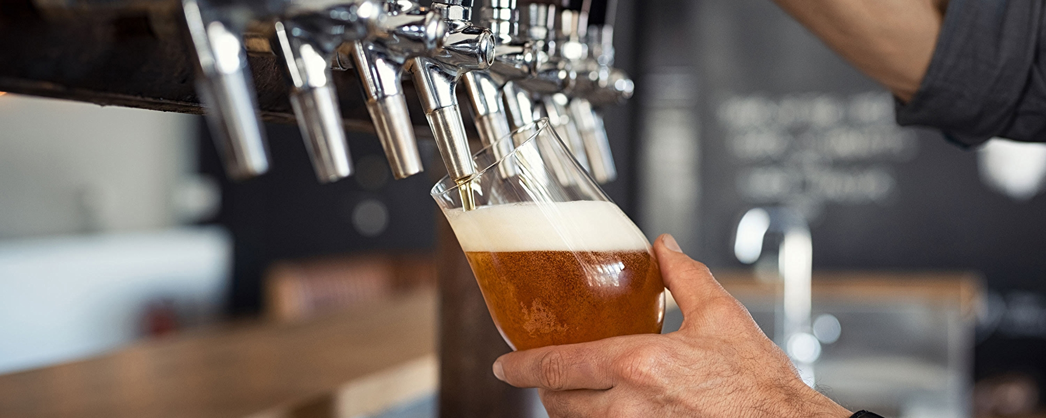
Beer Case Study
Presented By: Ben & Andrew

Slide 2
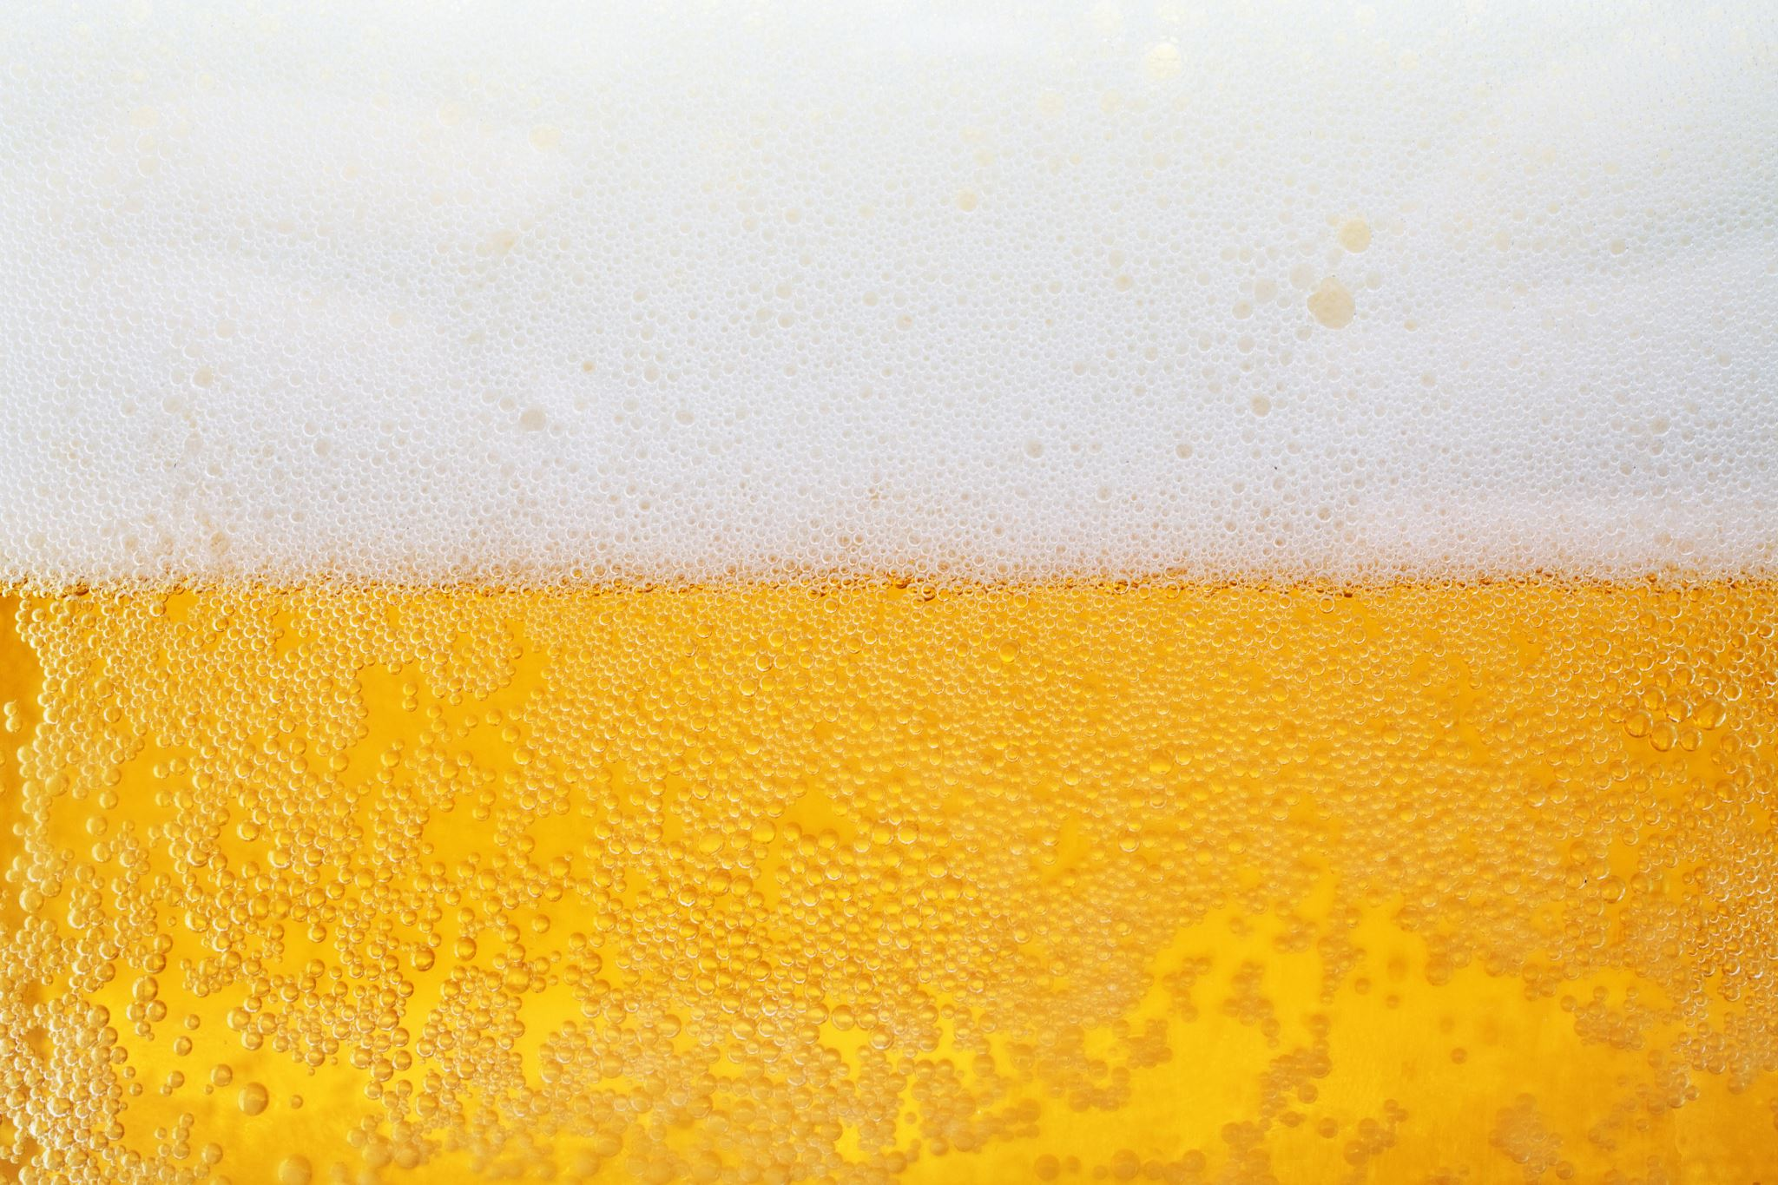
TABLE OF CONTENTS
01
Objective 1
Identify number of breweries in each state
Andrew
Objective 3
Address missing values
Andrew
03
04
Objective 4
Median ABV and IBU comparison
Andrew
Objective 5
C Compute market data about beers and breweries
Ben
05
06
Objective 6
Distribution of ABV
Ben
Objective 7
ABV vs IBU Comparison
Ben
07
08
Objective 8
KNN
Ben
Notes:
For Question#1 – number of breweries are present in each state

Slide 3
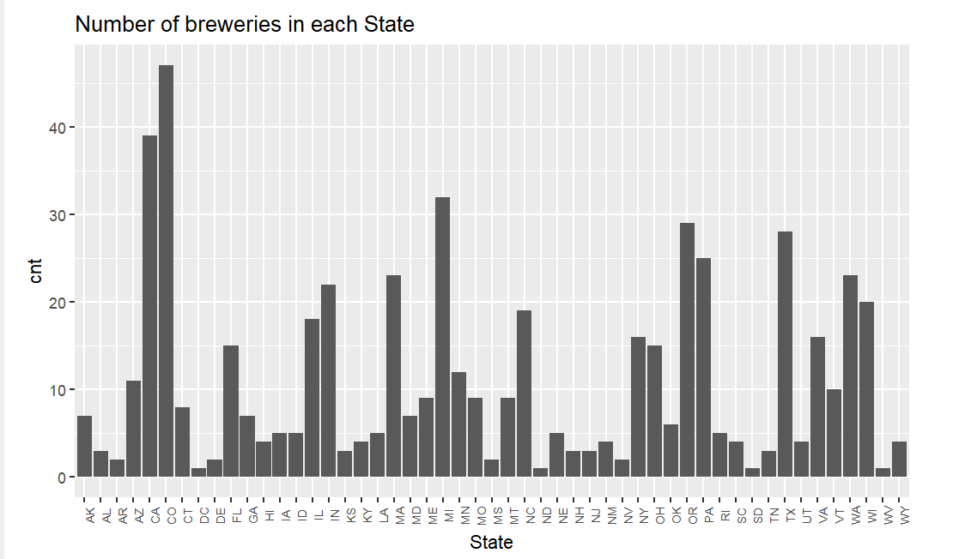
Objective 1
Identify number of breweries in each state
01
Which State Has Most Breweries
Colorado – 47
California -39
Michigan - 32
Notes:
For Question#1 – number of breweries are present in each state

Slide 4
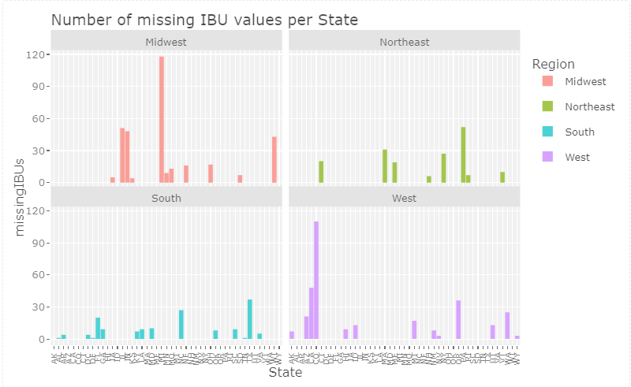
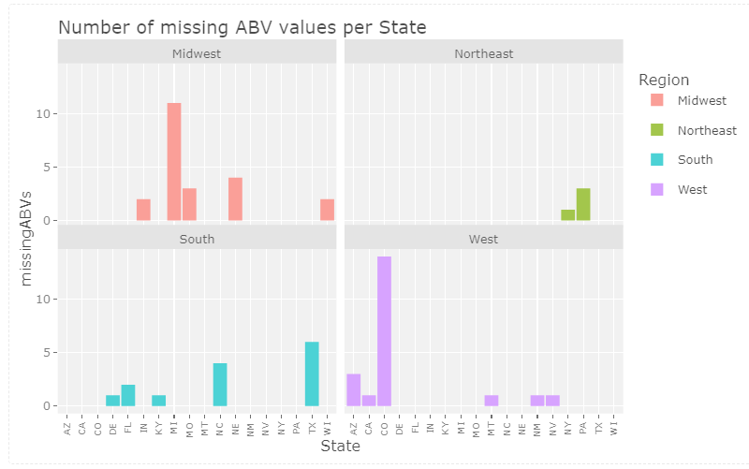
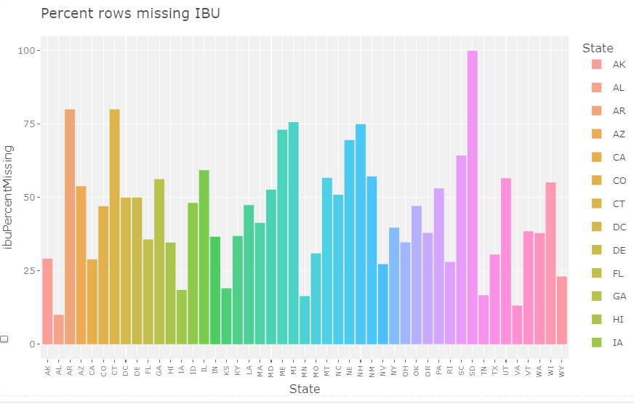
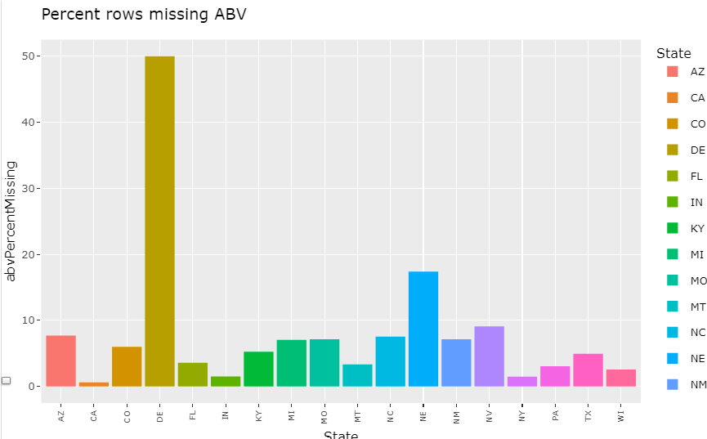
Objective 3
Address missing values
03

Slide 5
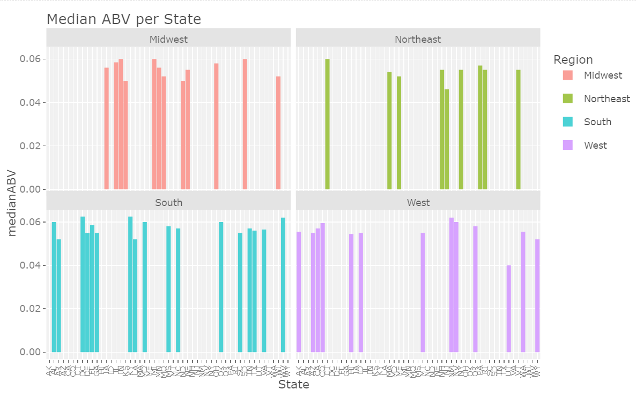
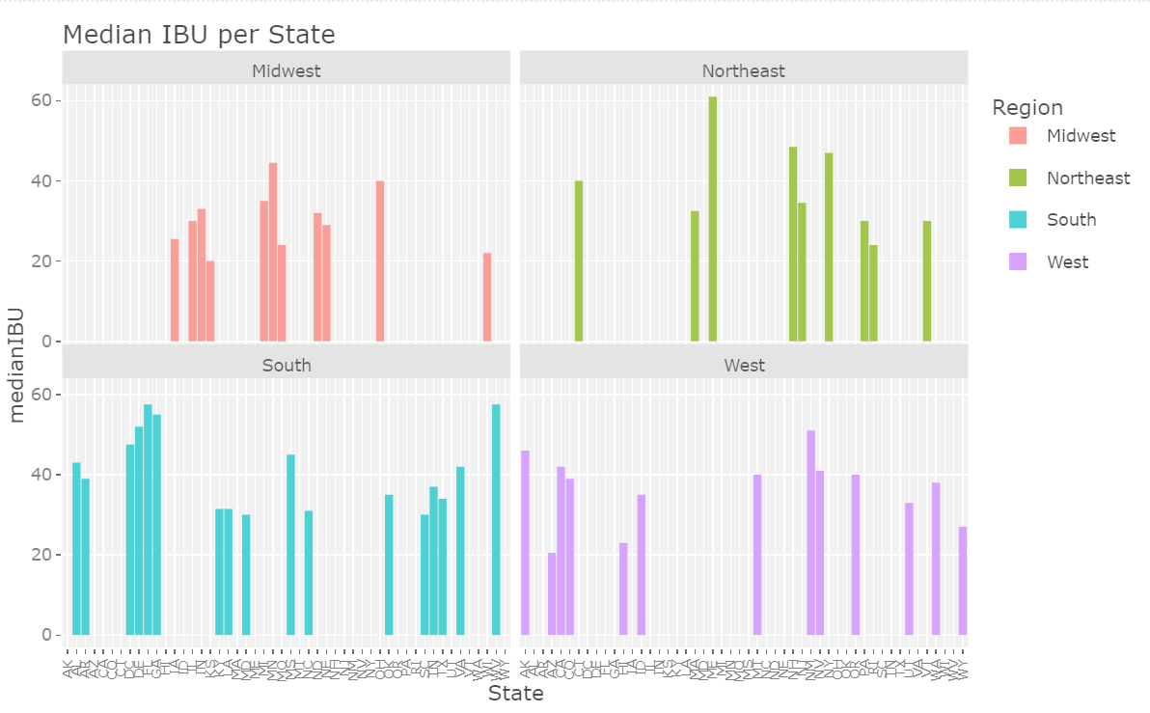
04
Objective 4
Median ABV and IBU comparison
The median ABV’s for the states/regions are roughly the same, with no significant outliers
The south shows graphical evidence for having higher median IBUs than other regions of the USA.

Slide 6
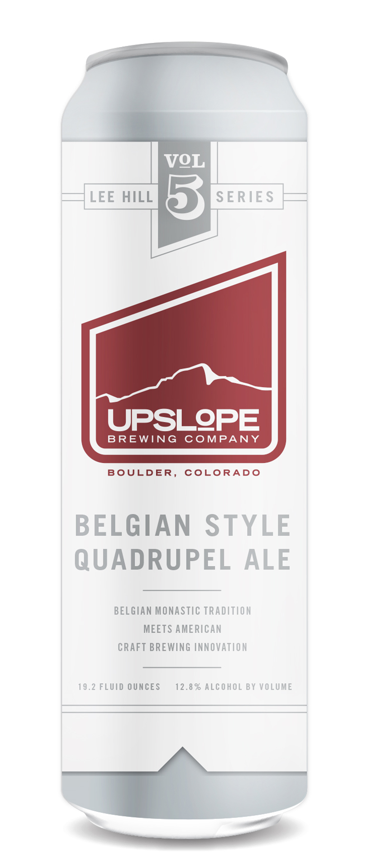
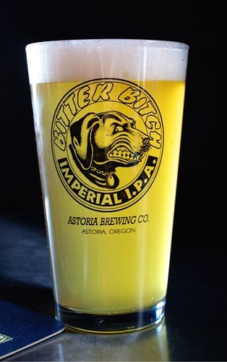
Objective 5
C Compute market data about beers and breweries
05
Which state has the Maximum Alcoholic (ABV) beer?
Which state has the most bitter(IBU) beer?
Lee Hill Series Vol 5 - Belgian Style Quadrupel Ale
.128 ABV
Colorado
Bitter Bitch Imperial IPA
138 IBU
Oregon

Slide 7
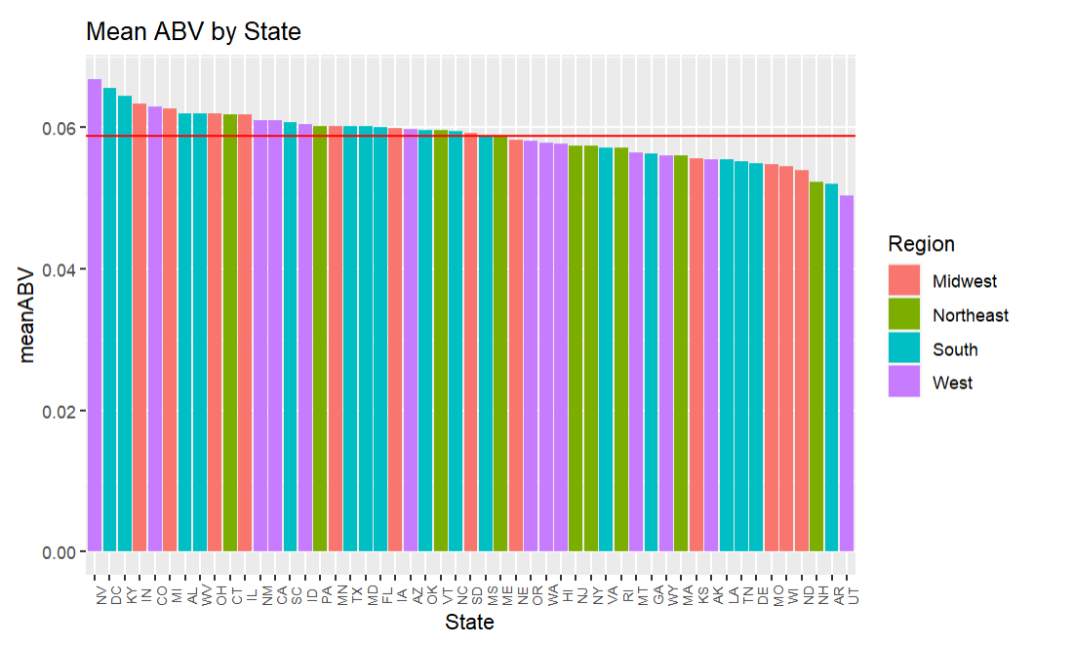
06
Objective 6
Distribution of ABV
The Avergae mean ABV of all the state is .0588. The number of states with an average higher than .0588 is 27. Geographic location most definitely has an impact on the ABV which could be an indicator on the people’s taste of that state, or maybe some other underlying variable. Beers in the south, on average, will have a higher ABV than other beers from around the nation.
Notes:
For Question#1 – number of breweries are present in each state

Slide 8
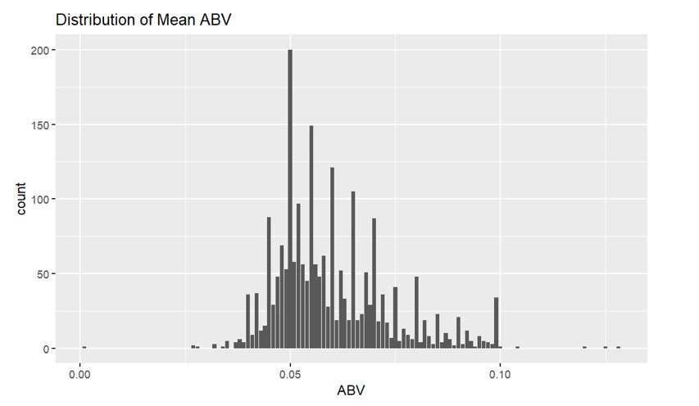
06
Objective 6
Distribution of ABV
The chart to the right is a histogram of the ABV of the beers. It is seemingly normally distributed, which looks to be centered just around an ABV of .05. Which isn't surprising, because that does seem to be the popular ABV of beers.
Notes:
For Question#1 – number of breweries are present in each state

Slide 9
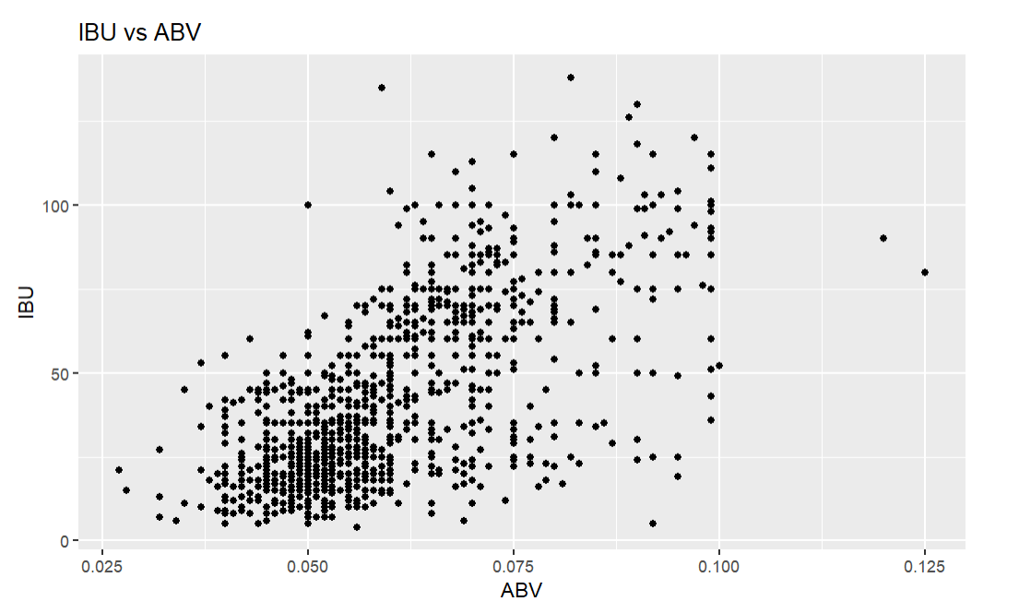
Objective 7
Find correlation/relationship with the found alcohol related data
07
Is there an apparent relationship between the bitterness of the beer and its alcoholic content?
To provide an answer to this question, we should look at the bitterness of the beer given the alcoholic content of the beer. The relationship is displayed left in the graph which indicate that there is a relative positive correlation. From this, it seems that the higher the alcoholic content of beer is, the taste of bitterness will be more apparent, or the IBU will be greater.

Slide 10
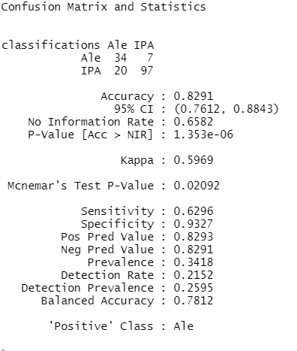
Objective 8
KNN: Classifying IPA or
not from ABV and IBU
Ben
08
From the training set, a test was “tested” to see how well we could identify if a beer is an IPA or an Ale based off of ABV and IBU.
The knn test, correctly identified the test data 82.91% of the time.
It also looks like IPAs were correctly identified more than Ales.

Slide 11


Questions?
Andrew Peng | LinkedIn
Benjamin Berger | LinkedIn
Video Presentation:
https://youtu.be/bmtNA3j7FlI
Github:
https://github.com/andrewpeng5/MSDS_6306_Project-Fall-2022

